Slide 1

Data Science Bootcamp Machine Learning

Slide 2
AGENDA
Overview
Linear Regression
Logistic Regression
Decision Tree
Metrices to check accuracy
Submission to a Kaggle Competition

Slide 3
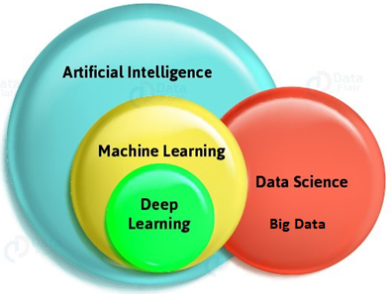
What is AI | ML | DL | DS
Source: Internet

Slide 4
What is AI?
In computer science, artificial intelligence (AI), sometimes called machine intelligence, is intelligence demonstrated by machines, in contrast to the natural intelligence displayed by humans and animals. -Wikipedia
“The study of the modelling of human mental functions by
computer programs.” —Collins Dictionary
Source: Internet

Slide 5
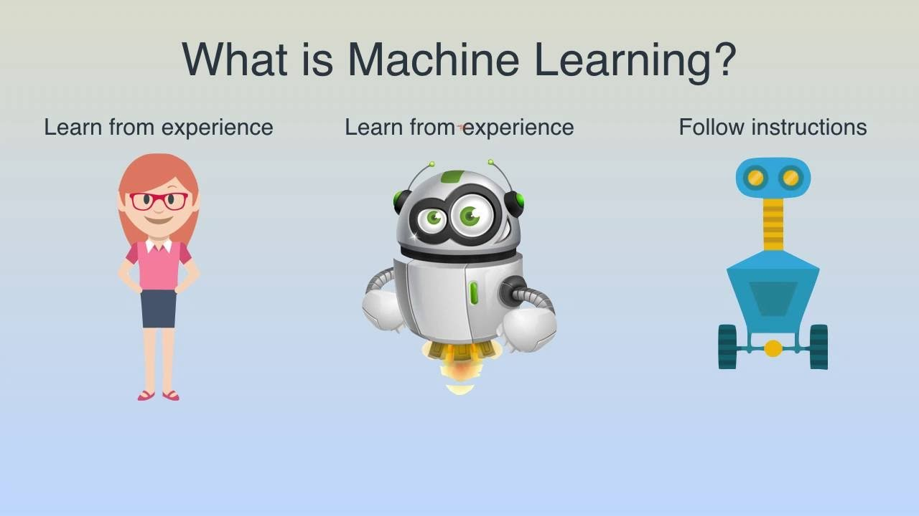
Source: Internet

Slide 6

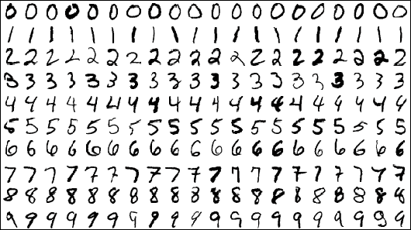
Use Case

Slide 7

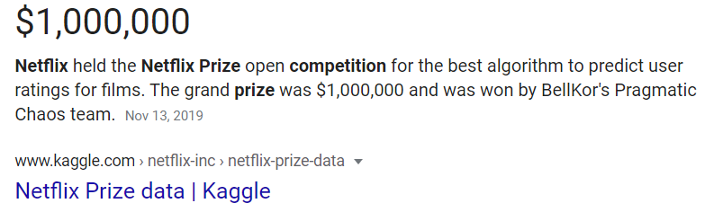
ML and Chill!!!

Slide 8
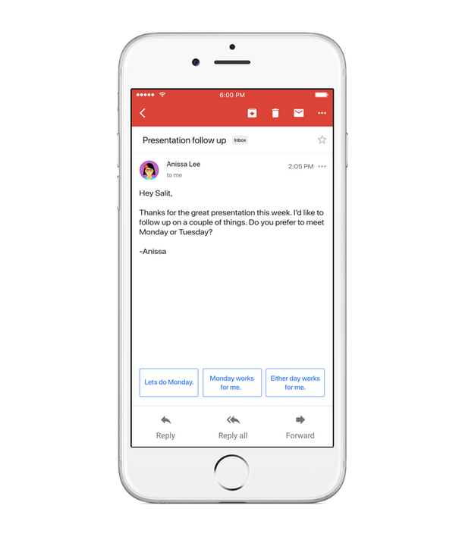
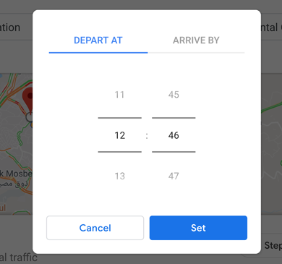
Do you like the smart reply or the traffic prediction?

Slide 9
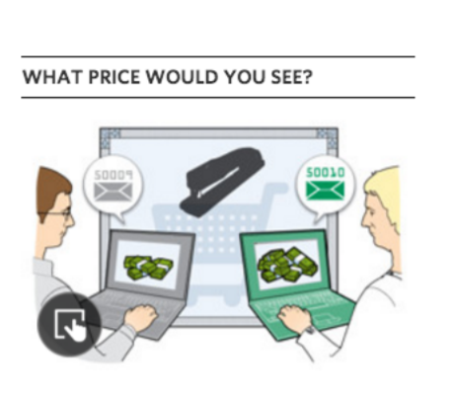

Things could go wrong too! If one is not careful with their model

Slide 10


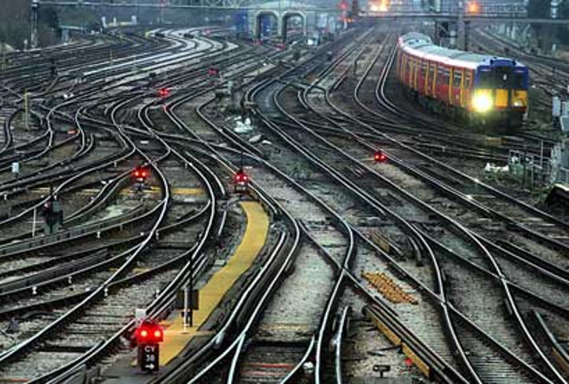

Slide 11
Linear Regression (today)
Logistic Regression (today)
Decision Tree
Random Forest
Naïve Bayes (advanced bootcamp)
K Means Clustering (advanced bootcamp)
KNN Algorithm
SVM (advanced bootcamp)
PCA
And much more….
Models

Slide 12
Definition!
A computer program is said to learn from experience E with respect to some task T and some performance measure P, if its performance on T, as measured by P, improves with experience E.
-Tom Mitchell (1998)
Q.
Suppose your email program watches you marking emails as spam/not spam and based on this learns how to better filter spam.
What is the task T in this setting?
a) Classifying emails as spam or not spam.
b) Watching you label emails as spam or not spam.
c) The number (or fraction) of emails correctly classified as spam/not spam.
d) None of the above—this is not a machine learning problem
Content in next few slides is taken from Andrew NGs course

Slide 13
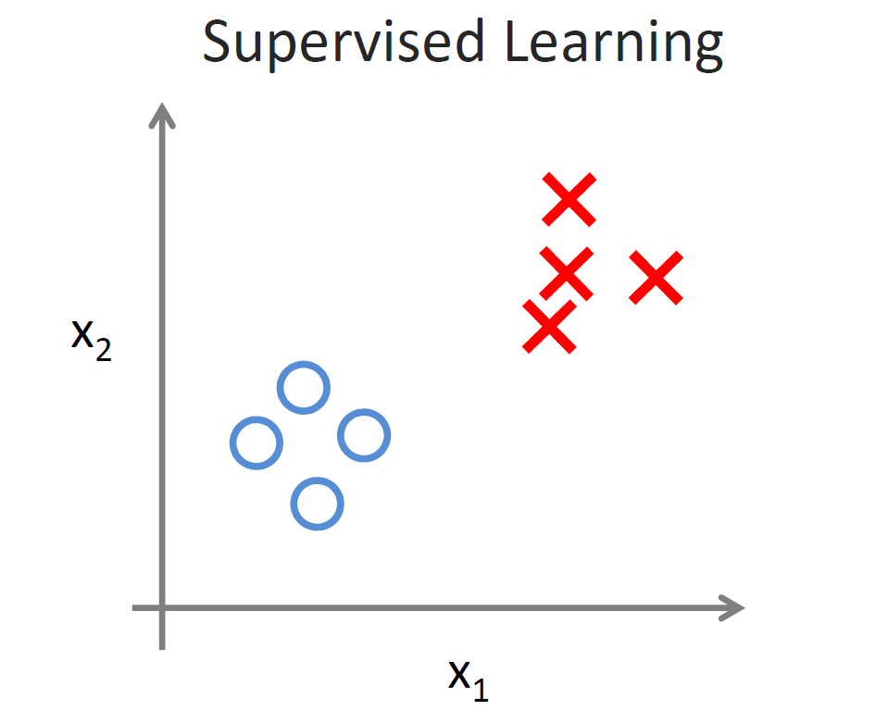
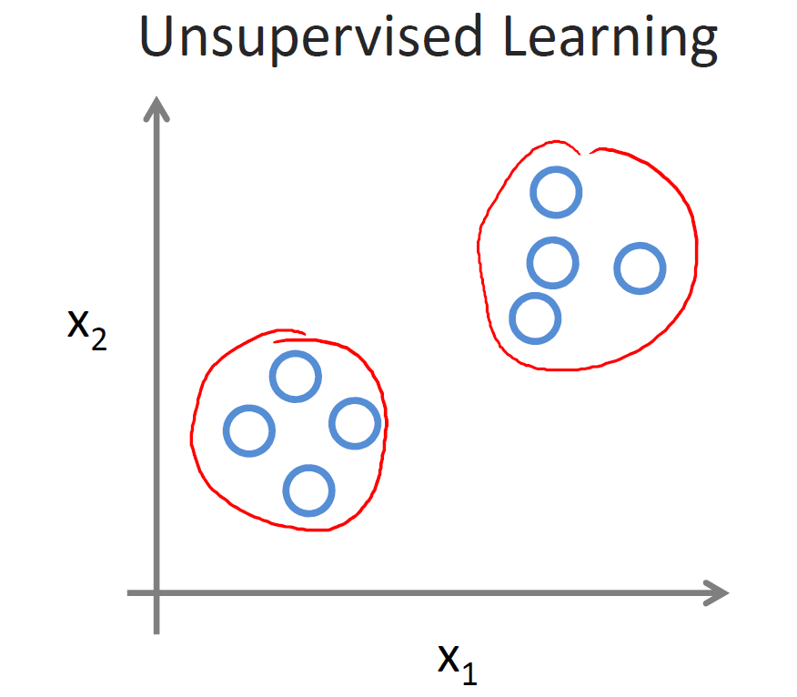
Types
input : right answers provided
(or) Data is Labeled
Process: Feedback provided
o/p : predictions
no right or wring answer
(or) no labels
no feedback
Clusters

Slide 14
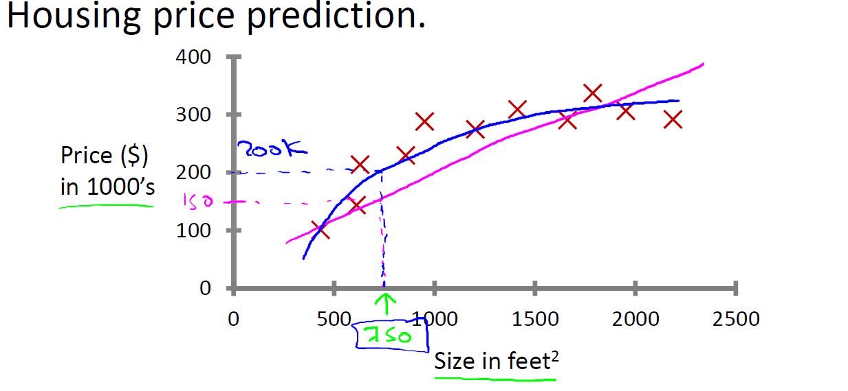
Regression: Predict continuous valued output (price)

Slide 15
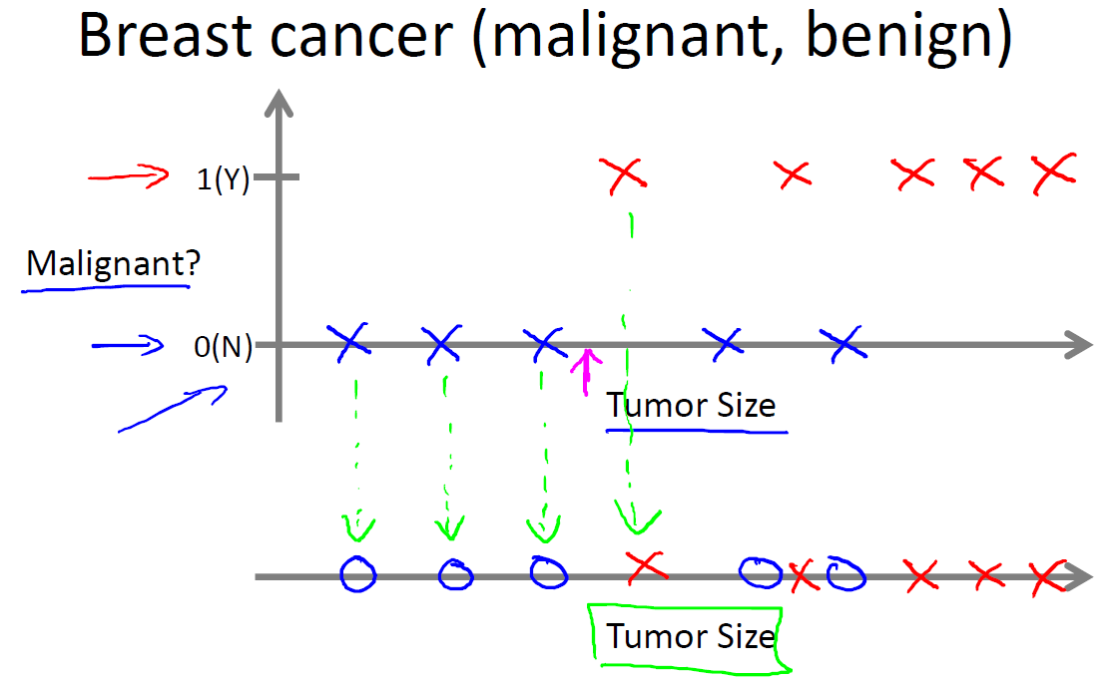
Classification
Discrete valued
output (0 or 1)

Slide 16
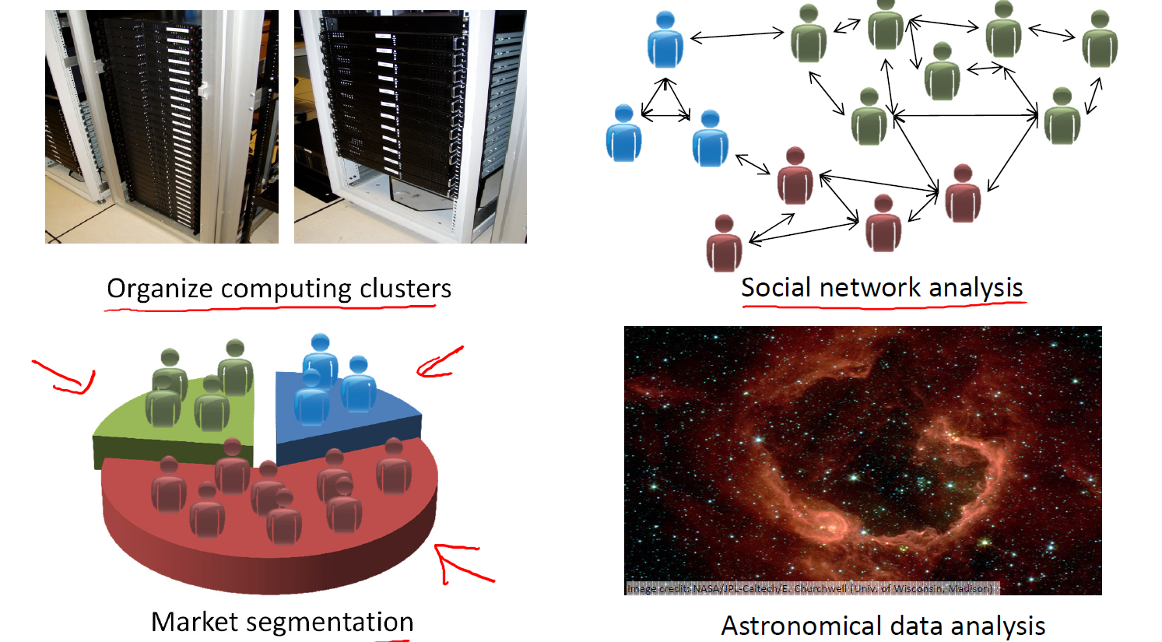
Clustering

Slide 17
Model Representation
General notation:
x ^{(i)} denotes the “input” variables / features
(e.g., area of house in the housing example)
y ^{(i)} denotes the “output” / target variable that we are trying to predict
(e.g., price).
A pair x^{(i)} , y ^{(i)} is called a training example.
The dataset that we’ll be using to learn— a list of m training examples i.e
x ^{(i)} , y ^{(i)}; i = 1, . . . , m
X/x used to denote the space of input values, and Y/y to denote the space of output values.

Slide 18
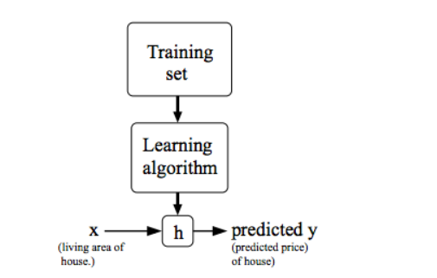
Supervised Learning Problem
Goal: Given a training set, learn a function h (hypothesis) : X → Y so that h(x) is a “good” predictor for the corresponding value of y.
Regression: When the target variable is continuous, such as housing price prediction.
Classification: When target variable can take only a small number of discrete values such as predicting if a house or an apartment.

Slide 19
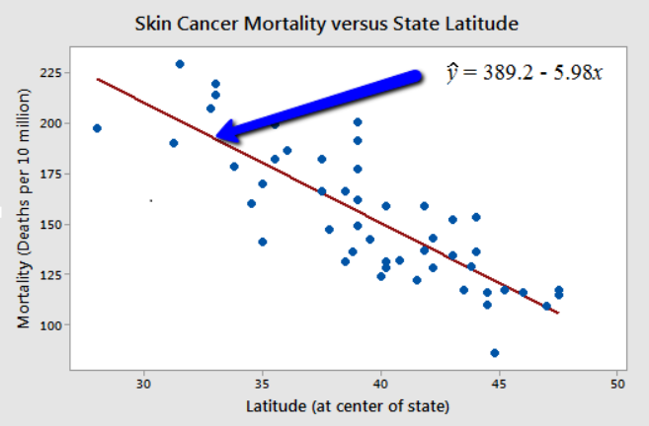
Basics of Linear Regression
F=9/5*C+32
y = θ₀X₀ + θ₁X₁

Slide 20
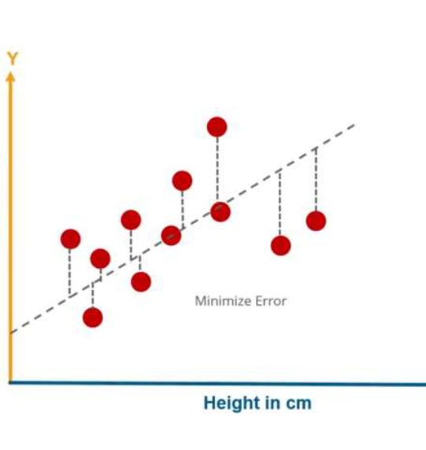
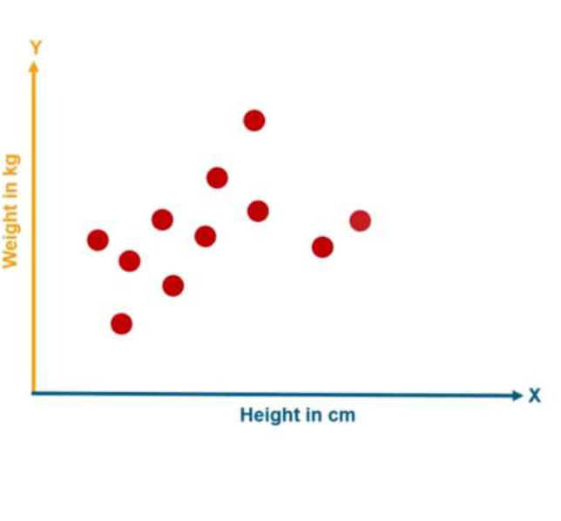
Predict weight based on height
Steps:
Start with a random line like w = h
Check error in prediction (hypothesis) and update
Stop when no change or threshold reached

Slide 21
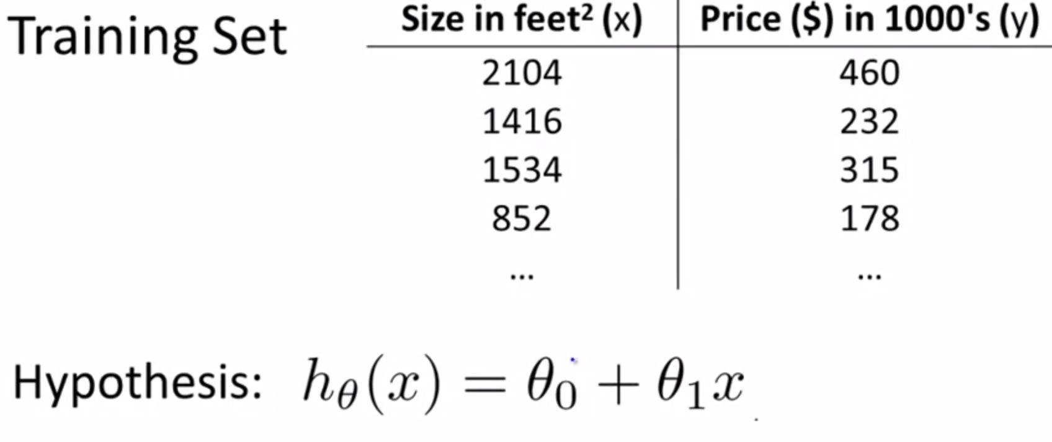
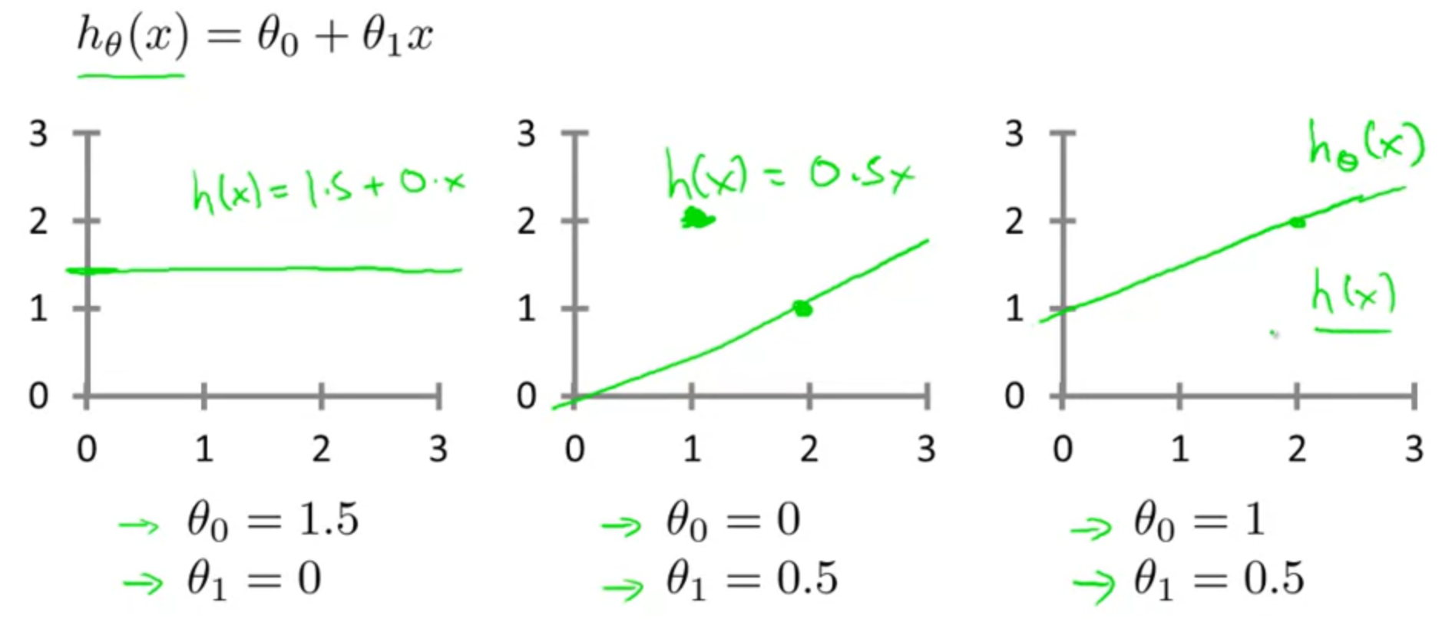
Hypothesis

Slide 22
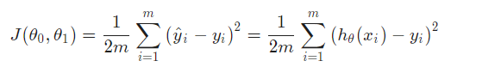
Cost Function
Accuracy of hypothesis can be measured by using a cost function.
Idea: choose Θ₁ Θ₂ so that the cost is the minimum.
It is an average of squared difference between actual output (y) and the hypothesis results with input x.

Slide 23
X
X
X
X
X
X
Cost: ((1.5-1)²+ (1.5-2)²)/2*2
= 0.5/4
Cost: ?
Cost: ((1-1)²+ (2-2)²)/2*2
= 0

Slide 24
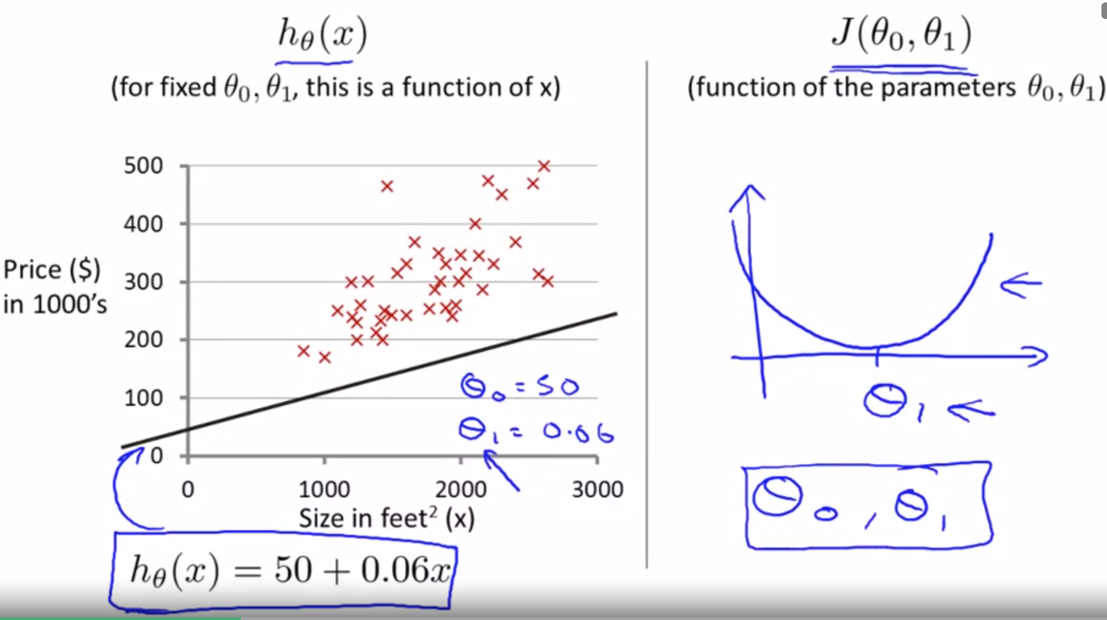

Slide 25
Question: What type of ML problem are these?
Facebook recognizing your friends face in a picture and asking you to tag them
Fraud Detection.

Slide 26
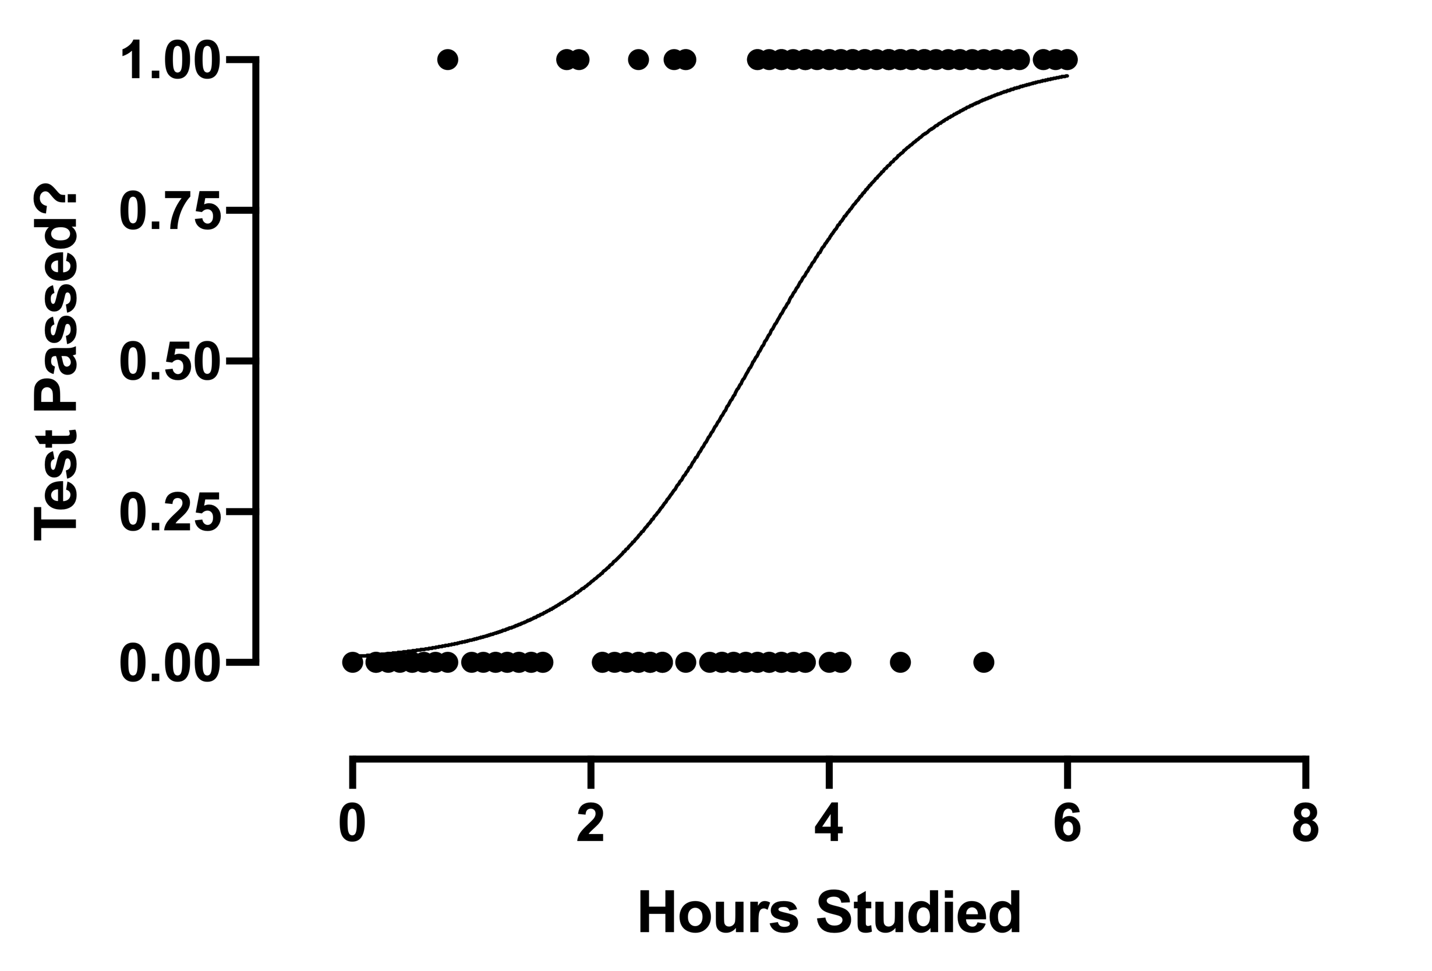
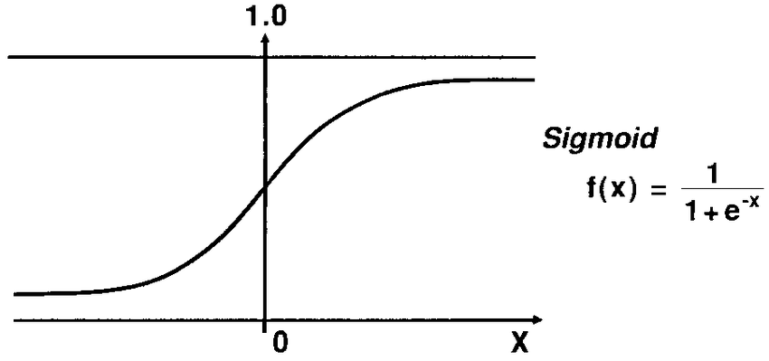
Logistic Regression
Works with probabilities
Odds of event Happening = P(happening)/ P(not happening)
log (P(x)/(1-p(x)))
In simpler terms: If m₁x₁ + m₂x₂ + ….m_{n}x_{n} gives linear regression output. Passing it to sigmoid will result in logistic regression output.

Slide 27
Multi Class Classification
Use one vs All approach.

Slide 28
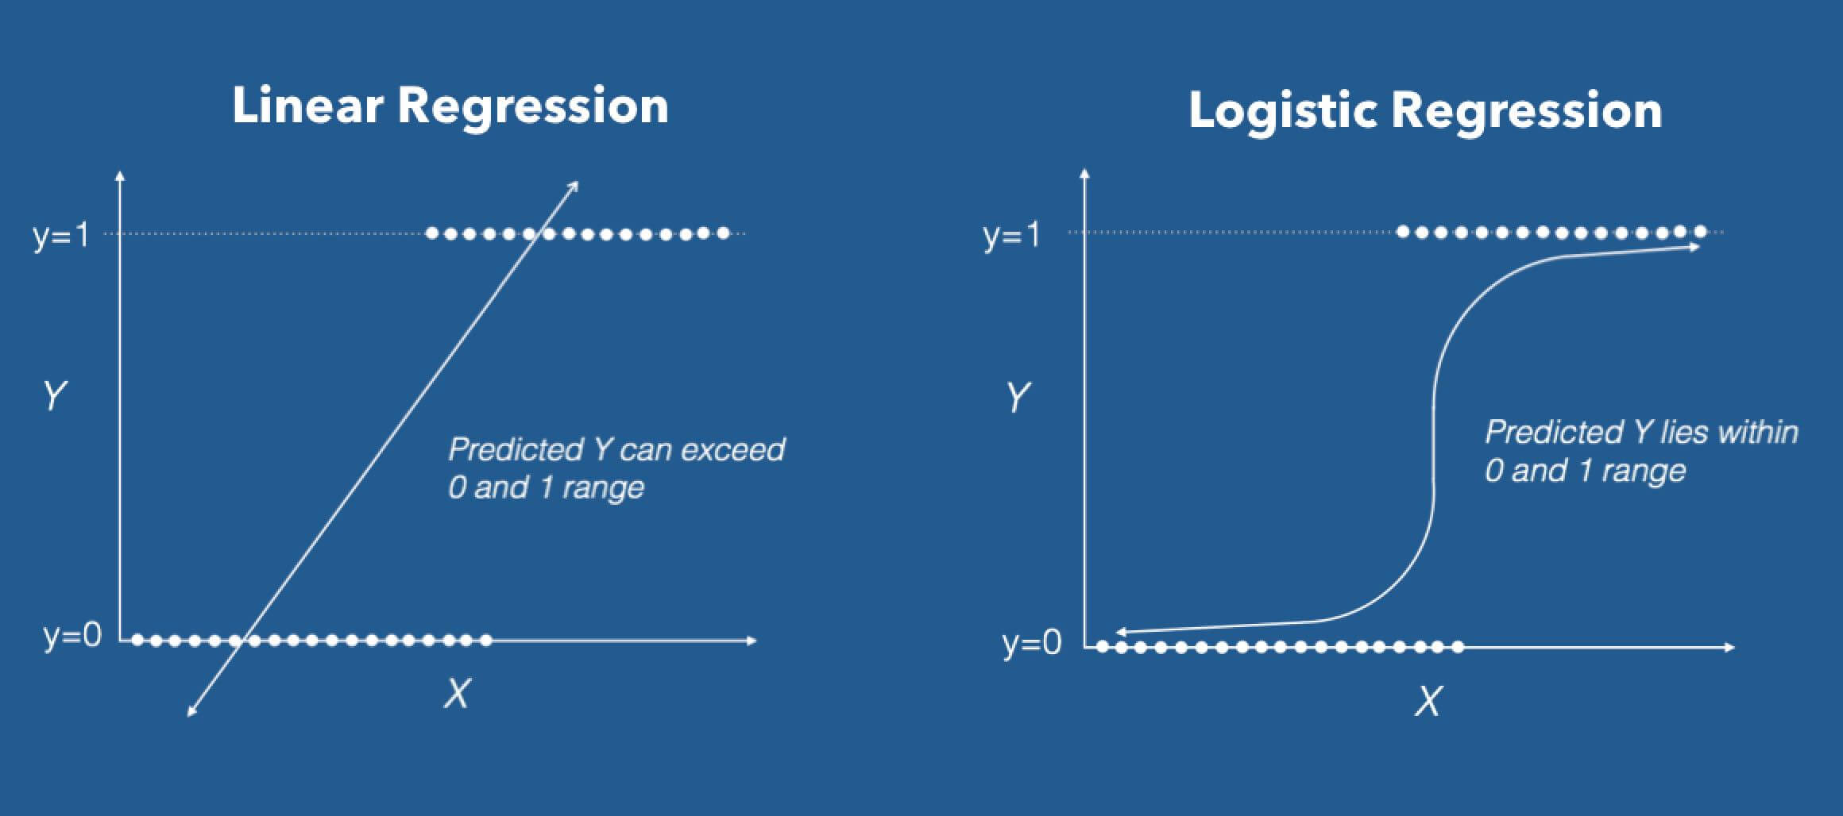
Linear Regression Vs Logistic Regression
Regression problems
Continuous variable
Estimate the dependent
Classification
Categorical response
Possibility of event occurrence

Slide 29
Encoding
Label : Simply assign numeric values to the values
One Hot Encoding:
Dummy Variable coding: One hot encoding with a redundant column removed
S.NO | Sex
1 | Male
2 | Female
3 | Female
S.NO | Sex
1 | 1
2 | 0
3 | 0
S.NO | Sex_female | Sex_male
1 | 0 | 1
2 | 1 | 0
3 | 1 | 0
S.NO | Sex_male
1 | 1
2 | 0
3 | 0
Original
Label Encoded
One Hot Encoded
Dummy Coded

Slide 30
Bias vs Variance Tradeoff
Solution to reduce Overfit
Reduce features
Regularization: L1, L2 norm

Slide 31
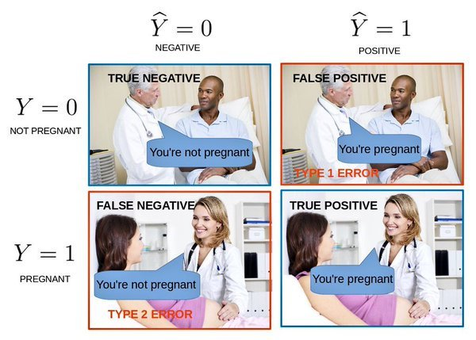
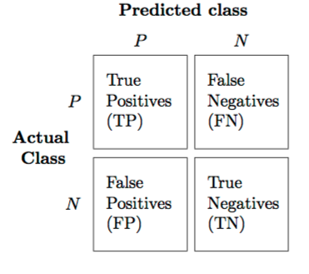
Confusion Matrix

Slide 32

Thank You ☺
Give Feedback!
Feedback link : link
Contact: datasciencebootcamp@nyu.edu

